Slide 1
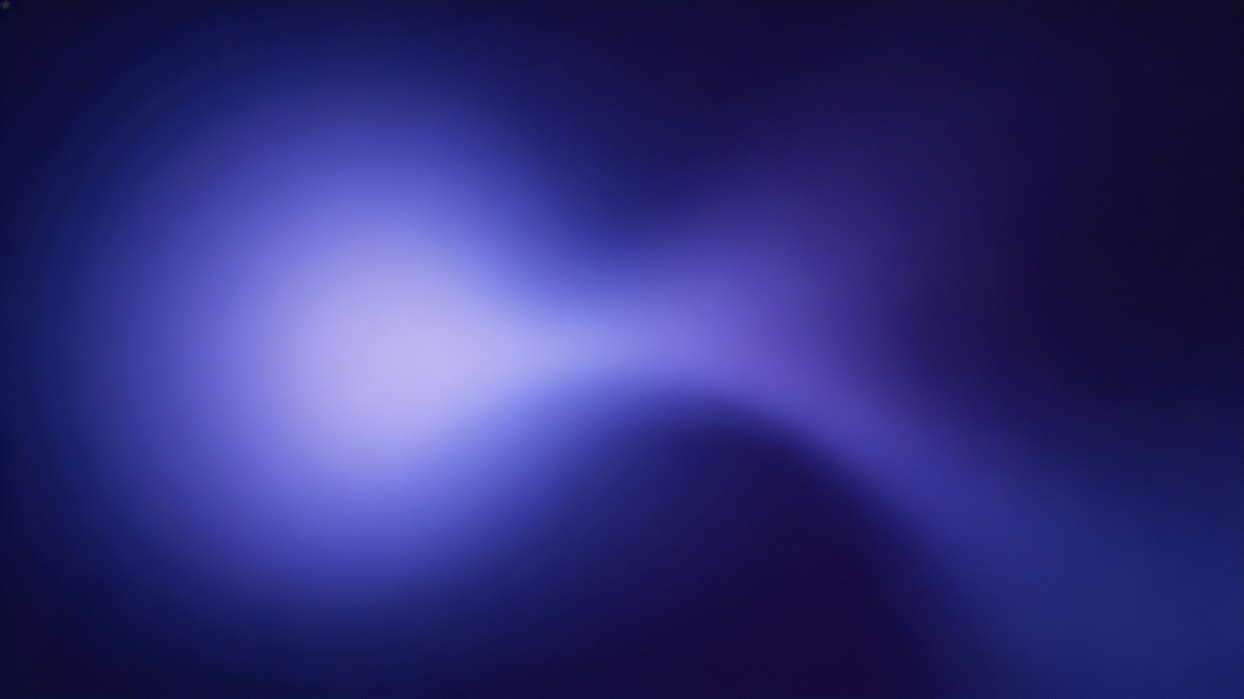
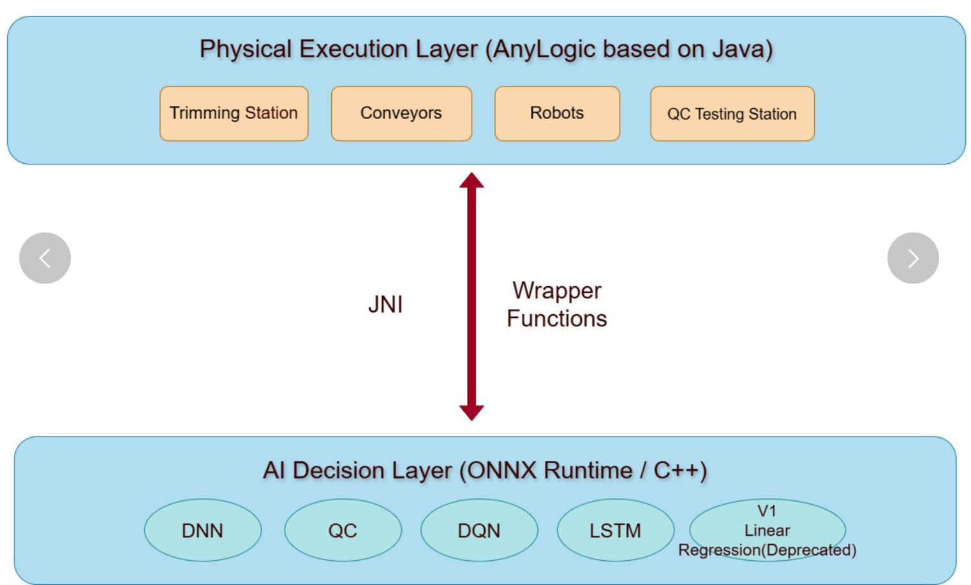
Dual-layer Decoupled Topology
DNN: Trimming Prediction
LSTM: Buffer Congestion Alert
QC: ONNX-based Classification
DQN: Robotic Routing
Base Model Credit: The AnyLogic Company : https://cloud.anylogic.com/model/29d54a61-aaac-4c47-8e50-941c0f5bb36e?mode=SETTINGS
Notes:
Hello everyone, today I'm excited to present our project on the Dual-layer Decoupled Topology, showcasing the evolution towards a Multi-Agent Digital Twin. This presentation will walk you through our journey from a single-point optimization model to a sophisticated, event-driven control system.

Slide 2

Version 1 Limitation: Single-Point Optimization
......
Unpredictable
Buffer
Linear Regression
Rigid Routing
Static Quality Check
......
Notes:
Our project is built on a dual-layer decoupled topology. The upper layer, developed in AnyLogic, handles the high-level simulation and logic. The lower layer, powered by ONNX and C++, executes the core AI models with high efficiency. These two layers communicate seamlessly via JNI. The core of our system consists of four specialized models: a DNN for trimming prediction, an LSTM for buffer congestion alerts, a QC model for quality classification, and a DQN for robotic routing.

Slide 3
Version 2: Multi-Agent Digital Twin
DNN
LSTM
Seamless Event-Driven Control
DQN
QC
Notes:
Our initial version, Version 1, relied on a single-point optimization approach using linear regression. While it worked for a specific task, it had significant limitations. The routing was rigid, the buffer behavior was unpredictable, and the quality check was static. This siloed approach couldn't adapt to the dynamic nature of the entire system, creating a clear bottleneck.

Slide 4



Performance Comparison: V1 vs V2
416 ➔ 427
Throughput (Units) — Significant Uplift
0.036 ms (on average)
Mean Inference Latency — Ultra-Low Response
Zero Lag
Simulation & Physical Process — Perfect Real-Time Sync
Notes:
To overcome the limitations of V1, we developed Version 2: a Multi-Agent Digital Twin. This version features four specialized AI models that work in harmony. As shown in the diagram, data flows seamlessly in a closed loop from the environment to the AI agents and back. This creates a self-optimizing system driven by real-time events, achieving what we call 'Seamless Event-Driven Control'.

Slide 5
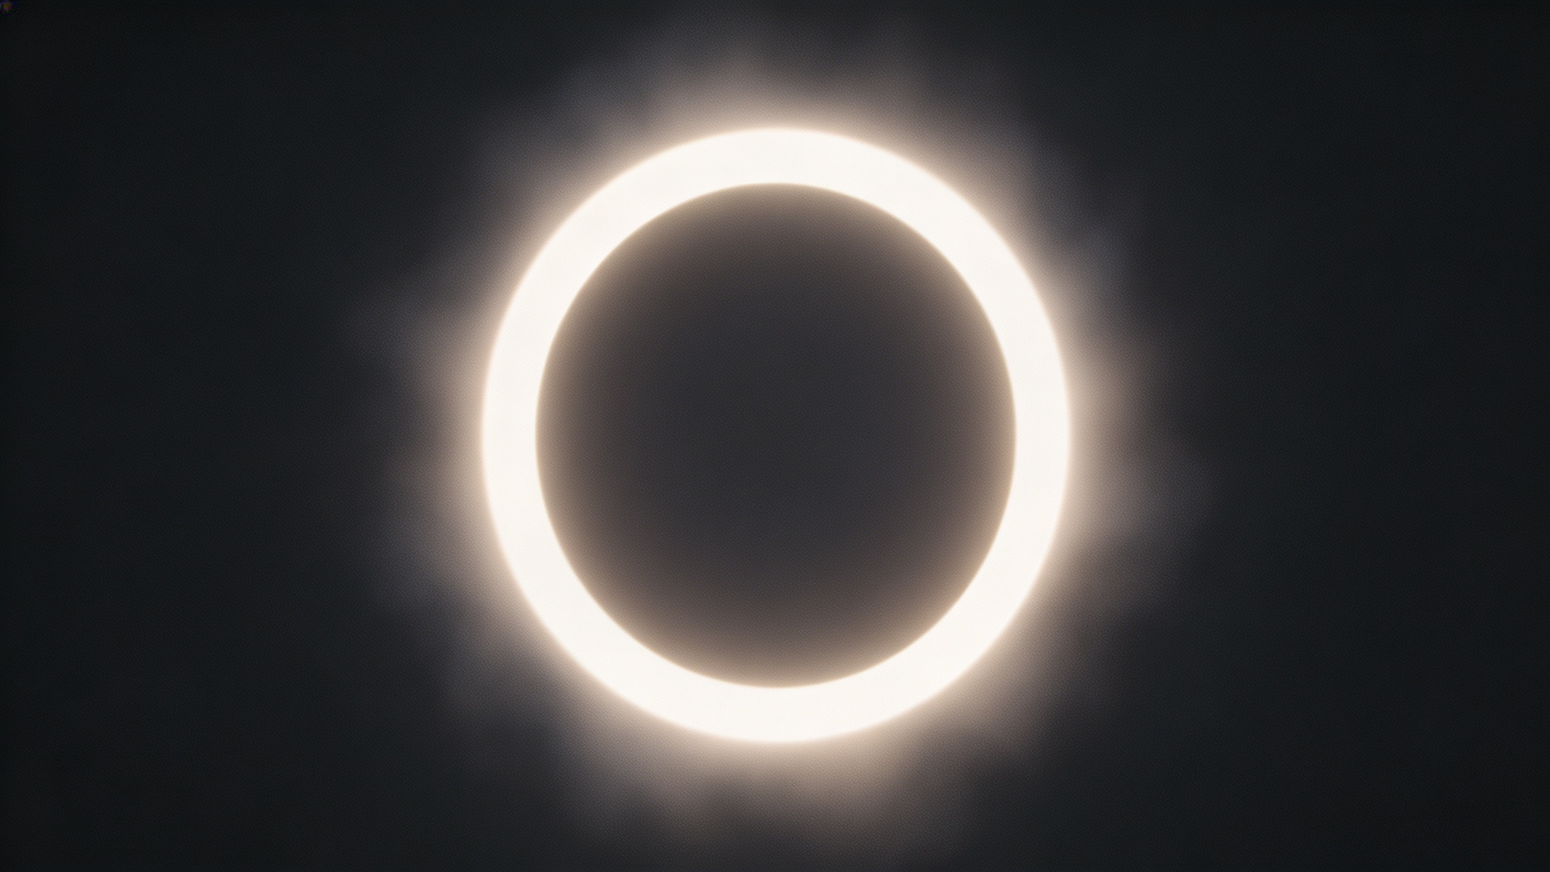
Comparison
Trade-off ：
AnyLogic PLE 5-hour limit restricted end-to-end output. Measured
upstream components instead.
GitHub: [https://github.com/etqqq/CS183-T14-Project-Repository]
Notes:
In conclusion, this project successfully demonstrated the power of a multi-agent digital twin. A key trade-off was the 5-hour limit of the AnyLogic PLE version, which restricted our end-to-end testing, so we focused on measuring the critical upstream components. For future work, we plan to upgrade to a cloud-based microservice architecture to handle even more extreme anomalies. Thank you for watching!

Slide 6
Results & Reflection
What worked ：
Multi-agent architecture successfully boosted throughput.
One limitation:：
Simulation constrained by 5-hour PLE memory limits.
Future Work ：
Refine multi-agent coordination to reduce congestion and optimize batch routing strategies.
GitHub: [https://github.com/etqqq/CS183-T14-Project-Repository]
Notes:
In conclusion, this project successfully demonstrated the power of a multi-agent digital twin. A key trade-off was the 5-hour limit of the AnyLogic PLE version, which restricted our end-to-end testing, so we focused on measuring the critical upstream components. For future work, we plan to upgrade to a cloud-based microservice architecture to handle even more extreme anomalies. Thank you for watching!

Slide 7
Thanks for Watching!
GitHub: [https://github.com/etqqq/CS183-T14-Project-Repository]
Notes:
In conclusion, this project successfully demonstrated the power of a multi-agent digital twin. A key trade-off was the 5-hour limit of the AnyLogic PLE version, which restricted our end-to-end testing, so we focused on measuring the critical upstream components. For future work, we plan to upgrade to a cloud-based microservice architecture to handle even more extreme anomalies. Thank you for watching!

